Slide 1
Neural Networks Lab

Slide 2
Predicting Quantitative Response

Slide 3
Example 1:
In lab 2, we covered an example to predict the price of a Porsche sports car using simple linear regression. In this example, we will build models to estimate the relationship between car price and age.

Slide 4
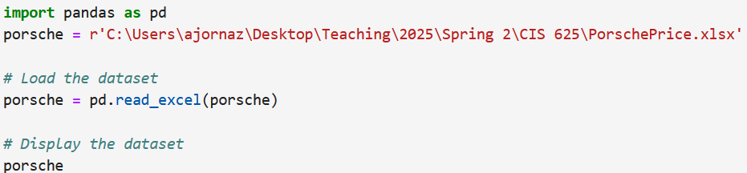
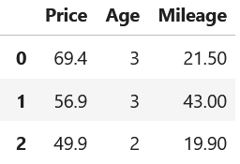
Import the dataset, and print out.

Slide 5
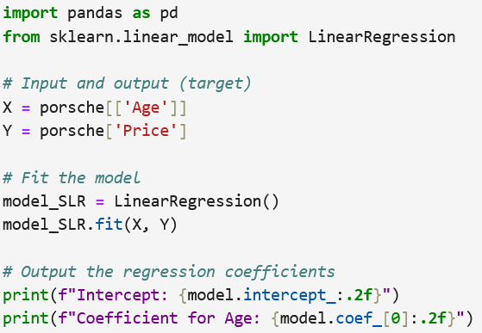
Fit a simple regression model for price and age.

Slide 6
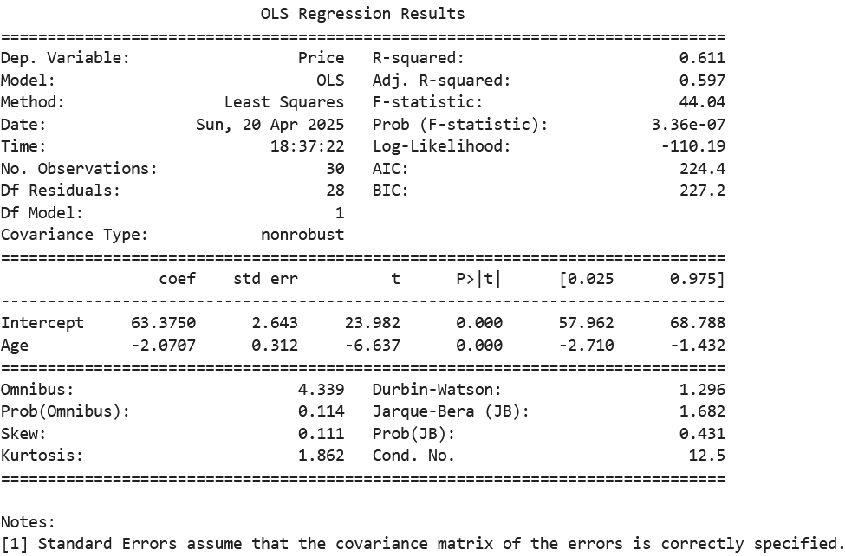
Table 1 The simple linear regression analysis results

Slide 7

Fit a neural network model for price and age.
Neural networks require scaling (or normalizing) the dataset. It didn’t apply that here to compare between regression and neural network.

Slide 8
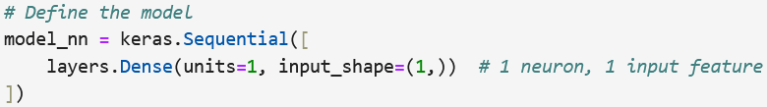
Models in Keras are defined as a sequence of layers.
Sequential is a Keras model type that is used for neural networks.
layers refers to the building blocks of a neural network. Each layer does some computation.
Dense is the most common and frequently used layer in a neural network.
units is amount of “neurons”/“cells”, the layer has inside it.
input_shape is used to tell the model number of inputs and what tensor shape should it expect.

Slide 9
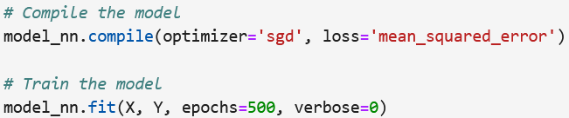
compile configures the model for training; it requires 3 key:
How the model updates weights (optimizer), there are several optimizers such as, adam, sgd, rmsprop, adagrad, etc.
What the model is trying to minimize (loss), there are several optimizers such as, MSE, MAE, binary_crossentropy, etc.
What to monitor during training (metrics), there are several optimizers such as, MSE, MAE, RMSE, accuracy, etc.
epoch is number of times the model will go through entire dataset.
verbose presents the steps of how the loss improves over time.

Slide 10
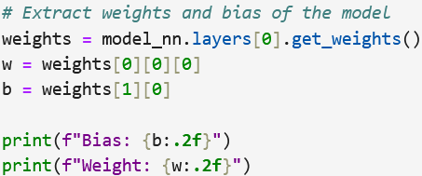
Weights and biases are essential components of the neural network.
Weights determine the strength of the connections between neurons, affecting how much influence an input has on the output.
biases are constant values added to the weighted sum of inputs, influencing the neuron's activation even when all inputs are zero.
Note: Bias is similar to the intercept in the regression model, and weights are similar to the regression coefficients.

Slide 11
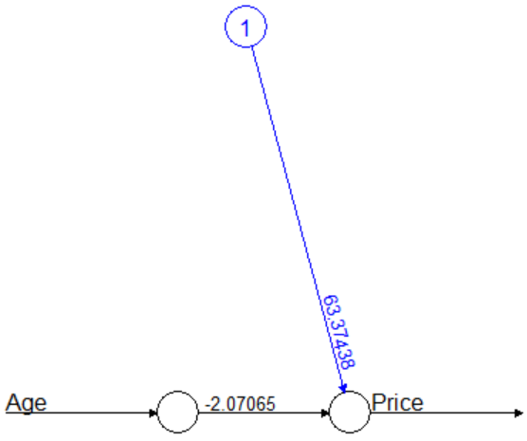

Visualize neural network architecture.
Simple linear regression coefficients

Slide 12
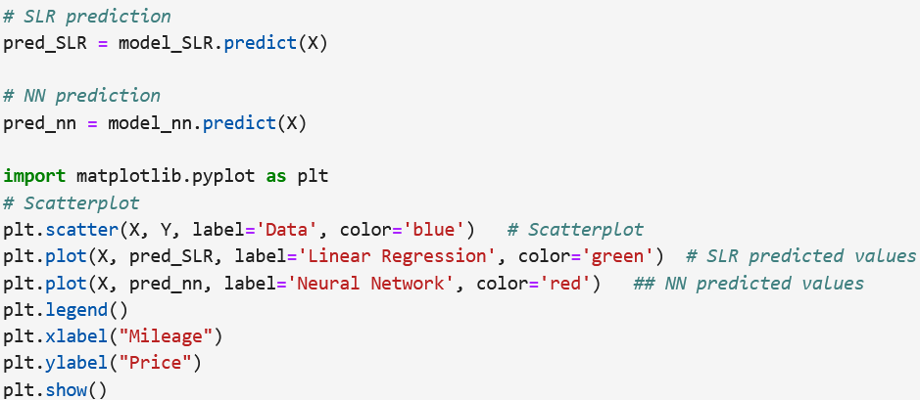
Find the predicted values of the two models and present them on the scatterplot.

Slide 13
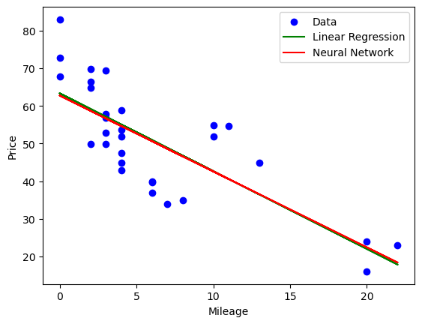
Figure 1 Comparison between the best-fit line and neural network predictions

Slide 14
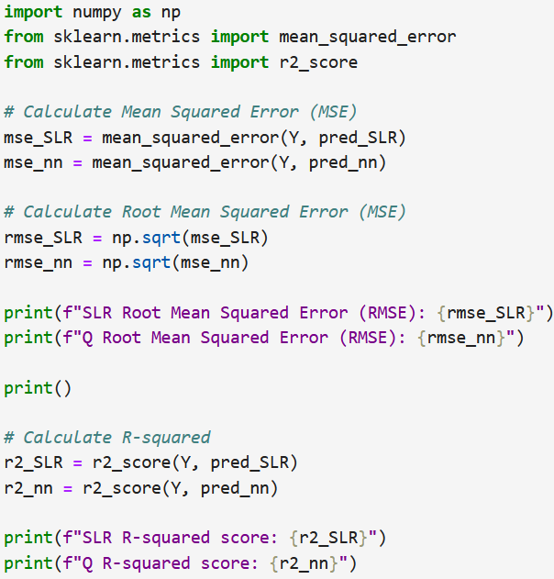
Evaluate the two models using the MSE and RMSE.

Slide 15
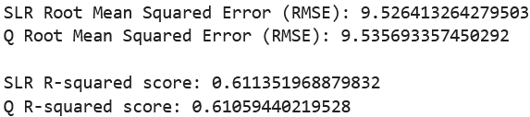
There is no significance difference between the two models. The simple linear regression model tends to fit the data better.

Slide 16
Predicting Binary Response

Slide 17
Example 2:
In lab 4, we covered an example to predicted acceptance (accept/denied) of undergraduate applicants in hopes of realizing their dreams to become physicians. The predictors are GPA, MCAT (MCAT subscore), Apps (Number of medical schools applied to), and Sex

Slide 18
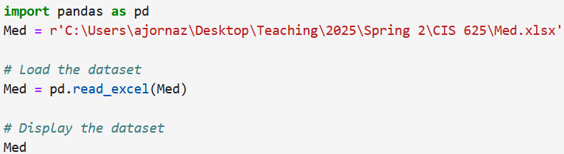
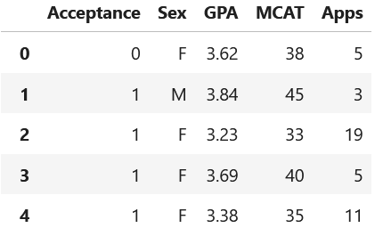
Import the dataset, and print out.

Slide 19
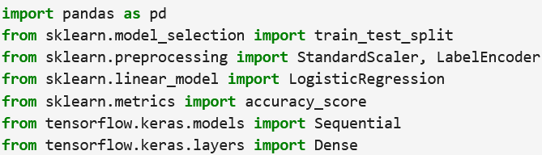
Import the required modules and libraries.

Slide 20
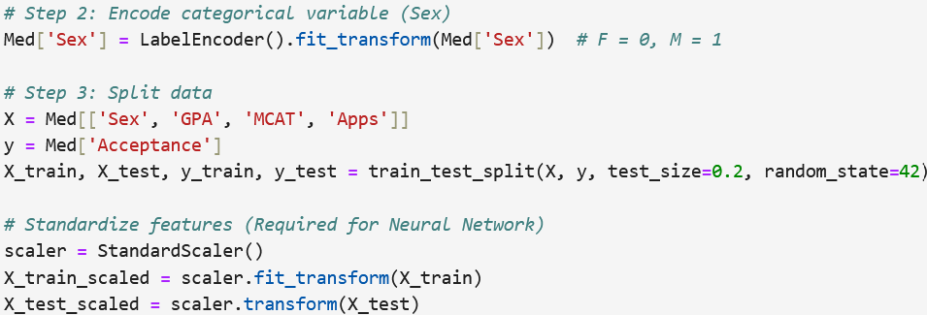
Convert the categorical variable “Sex” into dummy/indicator variable (0, 1), then split and scale the dataset .
Neural networks require scaling (or normalizing) the dataset.

Slide 21
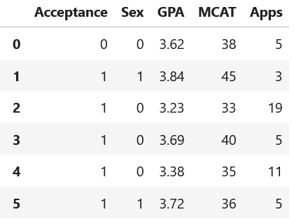
Table 1 The Med dataset after Encoding “Sex”

Slide 22

Fit a multiple logistic regression model to predict the acceptance.

Slide 23
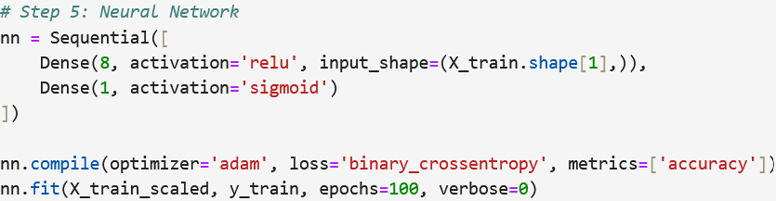
Fit a neural network model to predict the acceptance.
We set one hidden layer with 8 neurons.
There is one output neuron based on the sigmoid function.
We can add more hidden layers and neurons, but that would make the model more complex and could lead to overfitting.

Slide 24
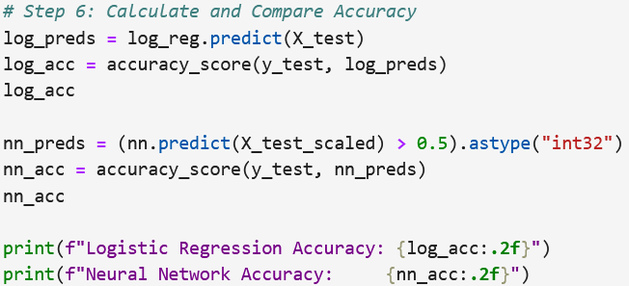
Evaluate the performance using confusion matrix. Calculate the models accuracy metrics.

Slide 25

The basic neural network model predicted the outcome of acceptance with accuracy = 73%.
When we re-run the code, we may get different results due to the randomly selection of the training and test subset.
Increasing the number of hidden layers and neurons can help improve the model’s accuracy.

